Slide 1
Simrank
Advanced Data Mining Presentation by Divij Singh

Slide 2
So what is SimRank?
Simply put, Simrank considers two objects to be similar if they are referenced by similar objects.
It is done by starting at a specific node, and following a random walker as it traverses the graph.

Slide 3
Strolling Through the Graph
Take a person randomly ‘walking’ on a social graph from node N. There is an equal probability of the person moving to any node sharing an edge with N, i.e. the neighbors of N.

Slide 4
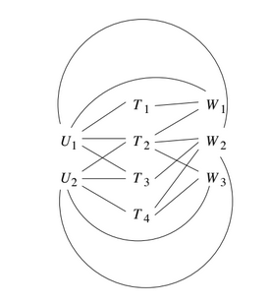
Take the example on the right. We’ll start at node T1. From here, we can either go to U1 or W1.
If we go to U1, we can go to T1 or T2 from there. If we go to U1, we can go to T1, T2 or T3.
So we see that by starting at T1, there is a decent chance of the walker visiting T2, better than the chance of it visiting T3 or T4.
You could try to infer that T1 and T2 are similar in a way, since they are both on a common webpage W1, and are both used by a common tagger, U1.
However, allow the walk to continue traversing the graph at random, and the probability of it being at any node is independent of the start. (Via the theory of Markov processes)

Slide 5
So what was the point of that?
We see from the previous slide that you cannot measure similarity to a specific node just by looking at the limited distribution of the walker.
However, we know from Pagerank that we can introduce a small probability that the walker will stop walking. We also see that we can select a subset of web pages as a teleport set, pages which the walker will go to when it stops surfing.
So, let’s take this idea to a greater level. We focus on a particular node N, and modify the matrix of transition probabilities to have a small, additional probability of transitioning to N from any node.
Let M be the transition matrix of graph G. That means the entry in row I, column j, of M is 1/k if node j of G has degree k, and one of the adjacent nodes is i. Otherwise, the entry is 0.

Slide 6
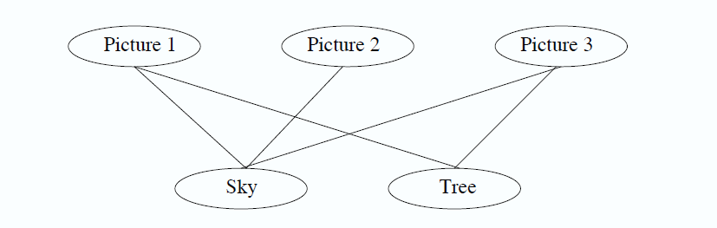
That’s kind of confusing. Let’s take an example.
Say we have a network with three pictures, and two tags; sky and tree.
Picture 1 and 3 have both tags, while 2 only has ‘Sky’. Intuitively, we know that Picture 1 is more similar to 3 than 2 is.
Let’s use a random walker to analyse this.

Slide 7
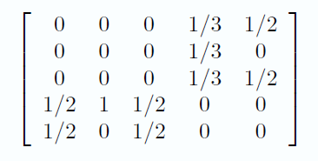
The Matrix
We’ll order the nodes in rows and columns, as Picture 1,2,3, Sky, and Tree. We get the matrix on the right.
For instance the fourth column represents Sky, which connects to the 3 picture nodes, giving it degree 3. Thus the non-zero entries are 1/3.
Since the first three nodes are the picture nodes, they are non-zero. Sky does not share an edge with itself or tree, so the other two entries are 0.

Slide 8
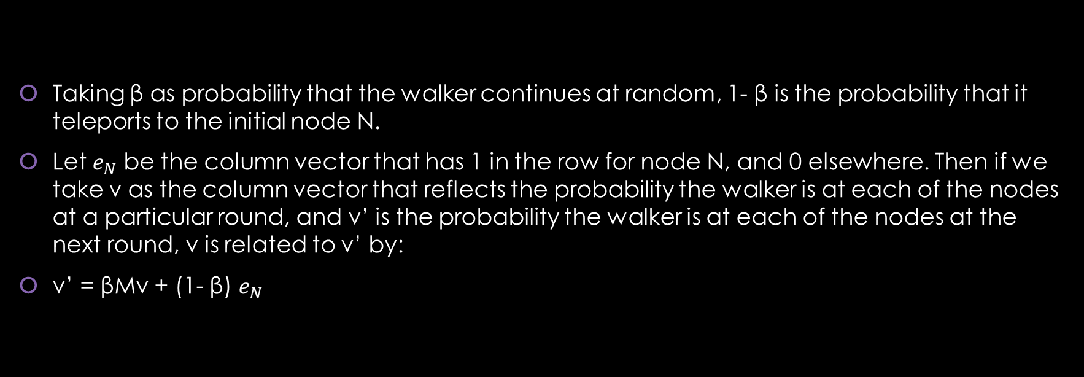
The Matrix Reloaded
Taking β as probability that the walker continues at random, 1- β is the probability that it teleports to the initial node N.
Let $e_{N}$ be the column vector that has 1 in the row for node N, and 0 elsewhere. Then if we take v as the column vector that reflects the probability the walker is at each of the nodes at a particular round, and v’ is the probability the walker is at each of the nodes at the next round, v is related to v’ by:
v’ = βMv + (1- β) $e_{N}$

Slide 9
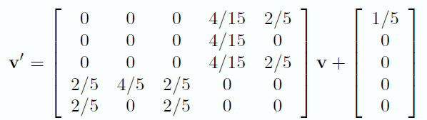
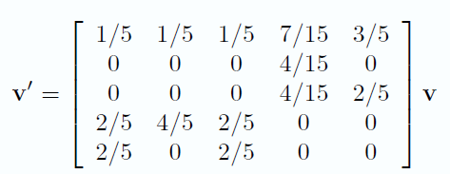
The Matrix Revolutions
So let’s take β=0.8, and that node N is Picture 1.
Then the equation for the new value of v’ is the first figure on the right.
Since the graph is connected, the matrix M is stochastic, and both v and v’ will have components that sum to 1.
Thus we can simplify the equation by adding 1/5 to each entry in the first row, giving us the second figure.

Slide 10
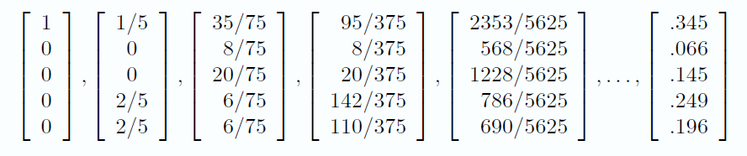
The Animatrix
If we start with V= n, then the sequence estimating the distribution of the walker is as above.
From the limit, we observe that the walker is more than twice as likely to be at Picture 3 than 2, confirming our intuition.
Do note that this analysis only applies to Picture 1, and must be redone for any other picture.

Slide 11
Yup
(That’s about it)

